Slide 1
DevOps Assignment
Team-1
Mentor : Tanmaya k Acharya

Slide 2
OBJECTIVES
Project Understanding
Technology
High Level Design Diagram
Design Diagrams
Minimal Viable Product
Learning
Screenshots

Slide 3
PROJECT UNDERSTANDING
The main objective of this project is to provide the user a form which provides issues and bug reports of different types of projects which are onboarded earlier
The issues and bug report informations will be maintained in SONARQUBE database.
Based on the type of application that has been selected, the report will be generated and prompts the user whether they have to proceed or not before submission.

Slide 4
TECHNOLOGY
Front End & Web Components:
Angular – 8
Business Logic Components And Services:
Spring Boot Version 2.1.7
Database:
SonarQube API
PostgreSQL

Slide 5
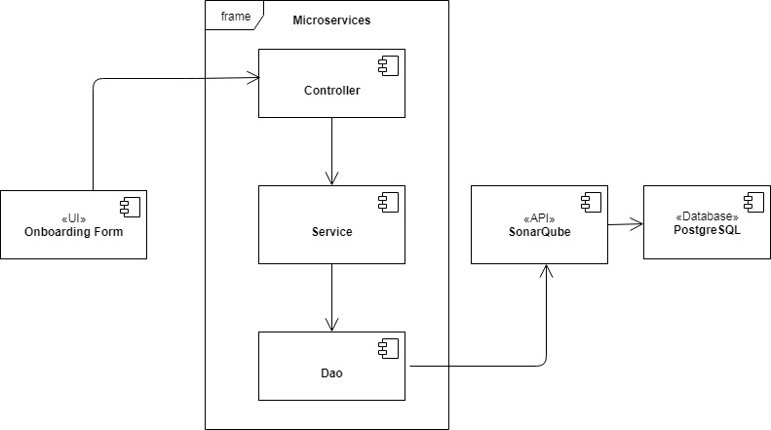
HIGH LEVEL DESIGN DIAGRAM

Slide 6
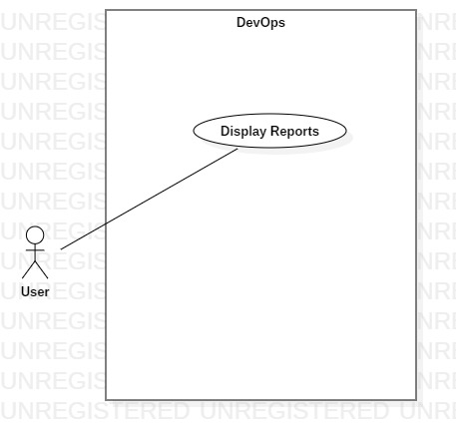
USECASE DIAGRAM

Slide 7
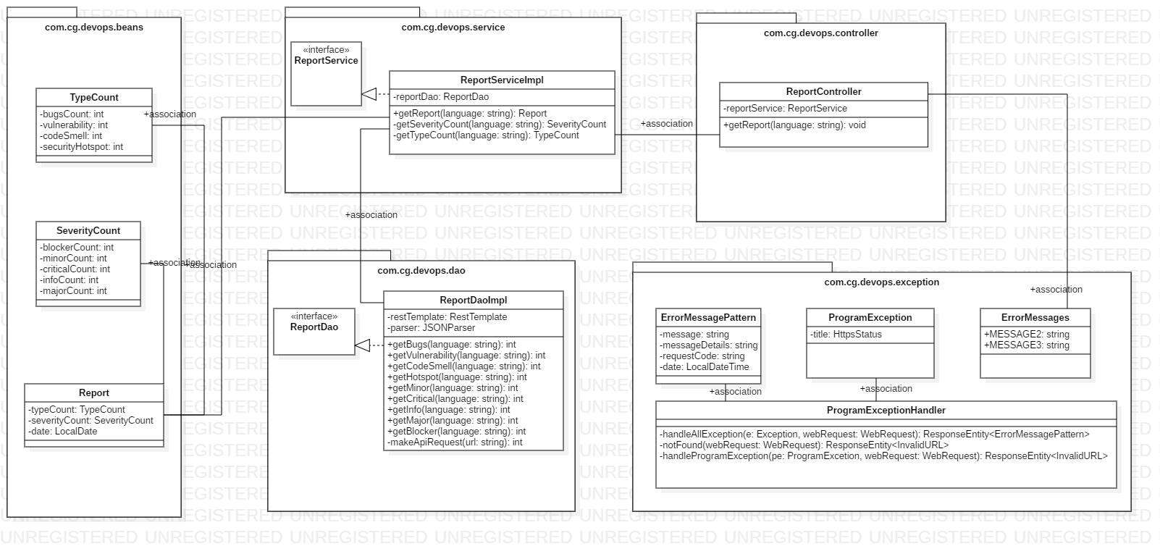
CLASS DIAGRAM

Slide 8
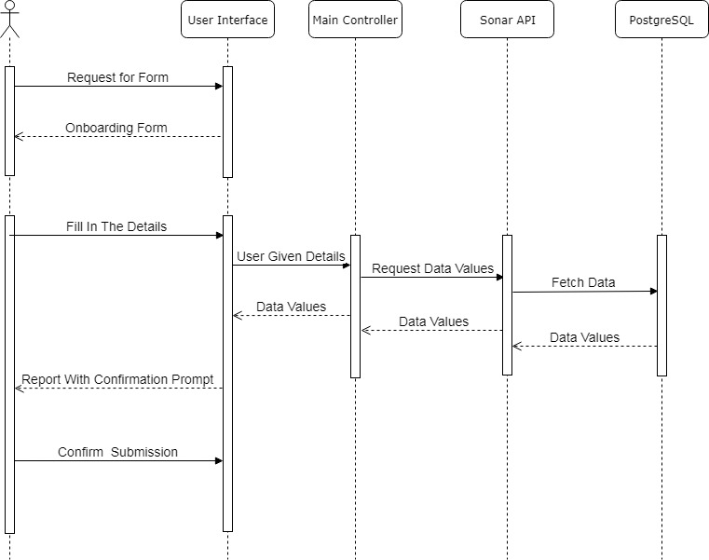
SEQUENCE DIAGRAM

Slide 9
MINIMAL VIABLE PRODUCT
MVP-1
Product | Description | Working Hours | Responsibility
UI | PopUp Report Regarding Type of Issues | 5 | Aman Vijay
Service | Filtering Issue Type Details From Api (Service Implementation) | 5 | Amit Kumar
Deployment | N/A

Slide 10
MVP-2
Product | Description | Working Hours | Responsibility
UI | PopUp Report Regarding Severity Count of Issues | 5 | Sakshi Goyal
Service | Filtering Severity Details From Api(Functional Implementation) | 5 | Sarika Yadav
Deployment | N/A

Slide 11
LEARNING
Learnt about the SONARQUBE in order to filter out the required details that has been fetched from the database through API.
Code Reviewing using PMD, which is a source code review/analyzer tool which helps the execution of code smoothly by finding bugs in our code.
Usage of a new database called POSTGRESQL to maintain the data regarding the analyzed report of types of applications that has already been onboarded through Jenkins.

Slide 12
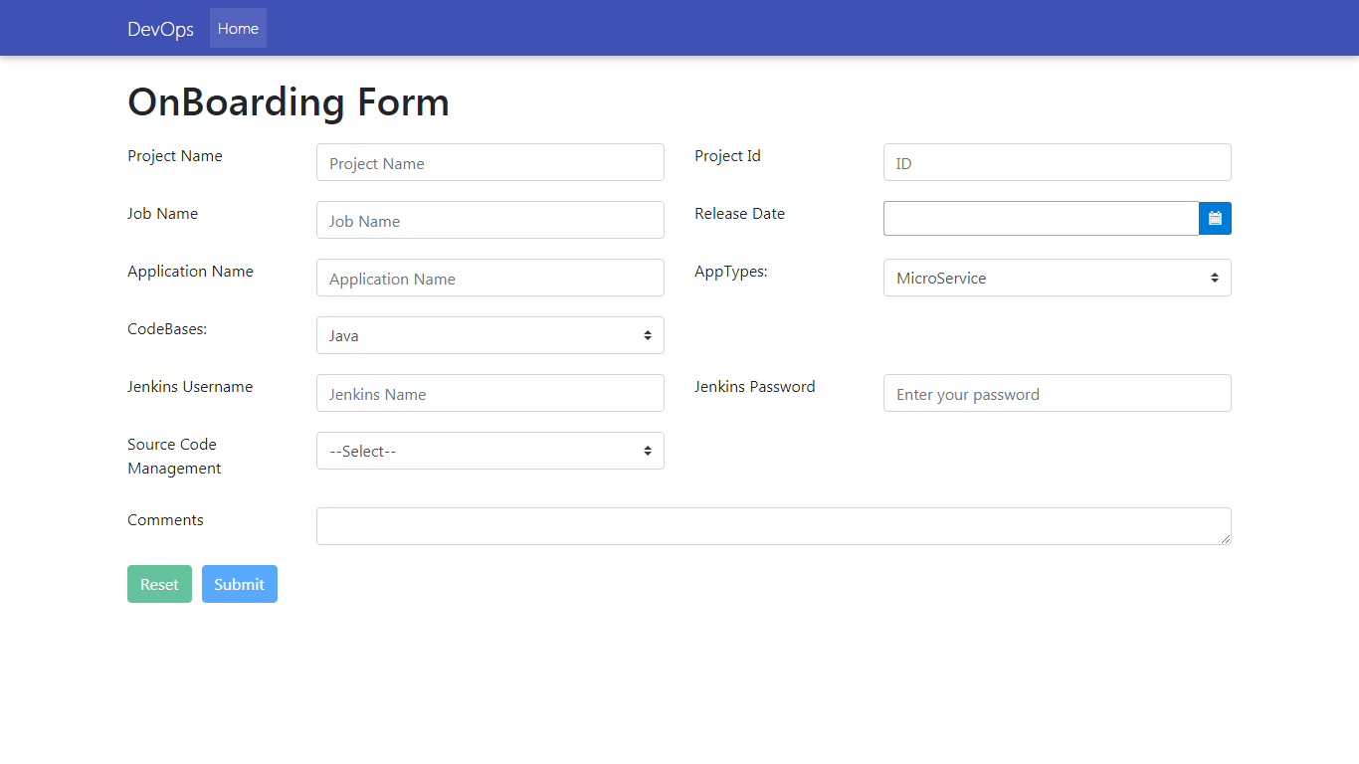
SCREENSHOTS

Slide 13
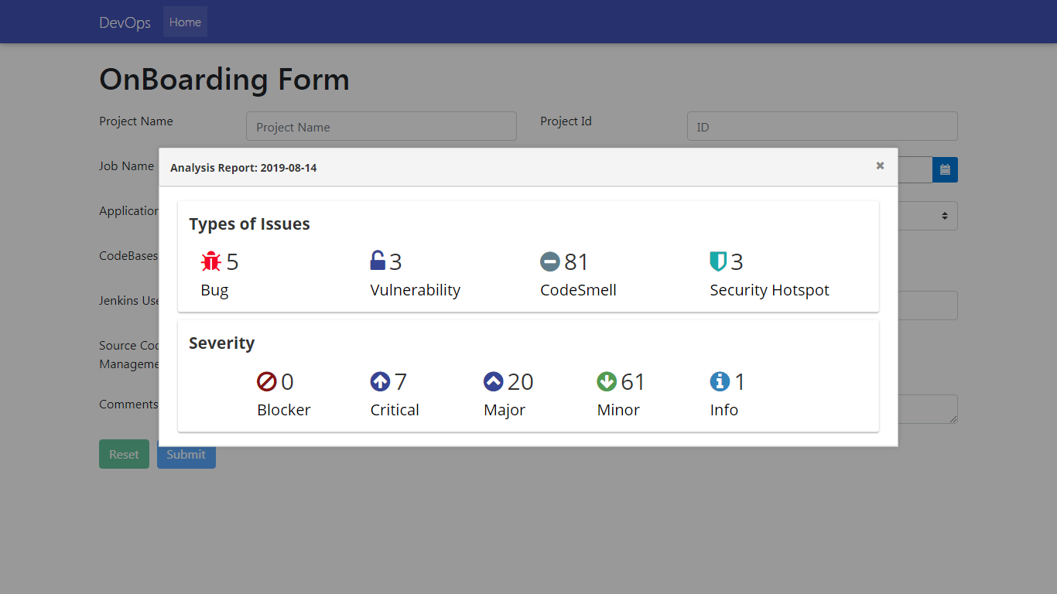

Slide 14
QUESTIONS?

